Slide 1




X
Grocery Store Operational Analysis using AI
Capstone Project – Customer & Location Intelligence
Rudi Rahayu
July 2025

Slide 2


X
Raw Dataset Overview
Dataset Name: Grocery_Stores.csv
Source: Capstone public dataset
Fields: Address, City, ZIP, SquareFeet, Notes, Coordinates, etc.

Slide 3

X
Project Overview
Analyze grocery store distribution, size, and operational status in Detroit.
Leverage AI (IBM Granite) to extract insights from unstructured 'Notes' data.
Support business decisions: expansion, validation, digital readiness.

Slide 4



X
Analysis Process
Data cleaning & missing value check
Mapping store locations with Folium
Distribution charts by city and ZIP code
Store size classification
AI-based note classification using IBM Granite

Slide 5


X
Insights & Findings
🔵 Most stores are located in ZIPs 48204, 48238, 48214
🏪 55% are medium-sized stores (10k–20k sq ft)
⚠️ 50% stores lack complete geolocation
❌ AI identified multiple stores as likely closed based on notes

Slide 6
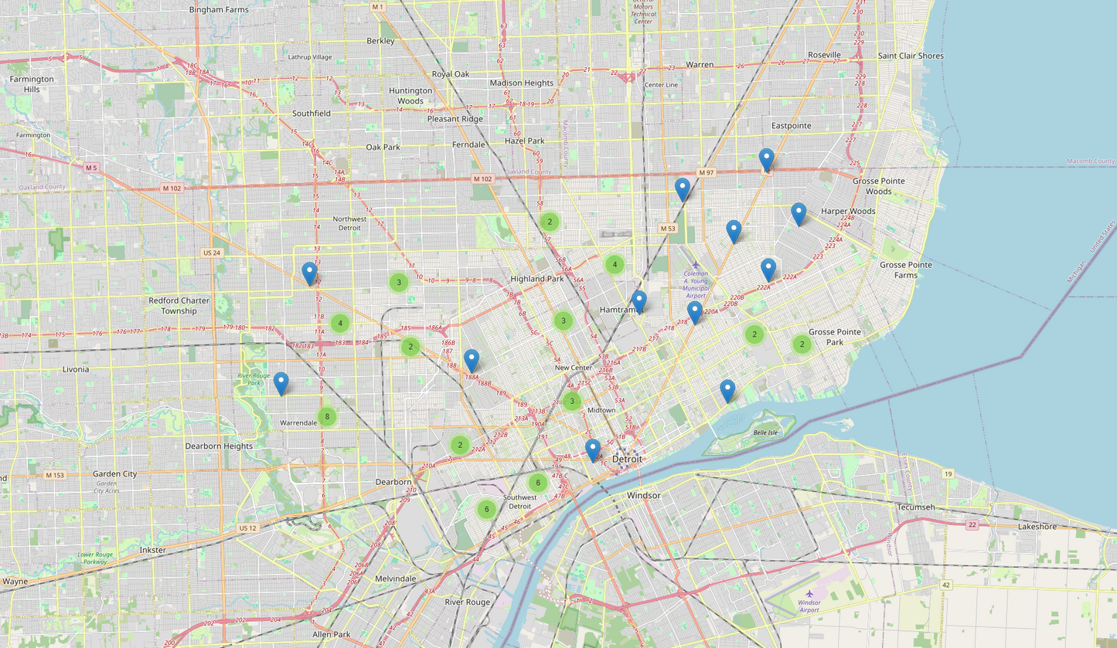
X
Visualization

Slide 7
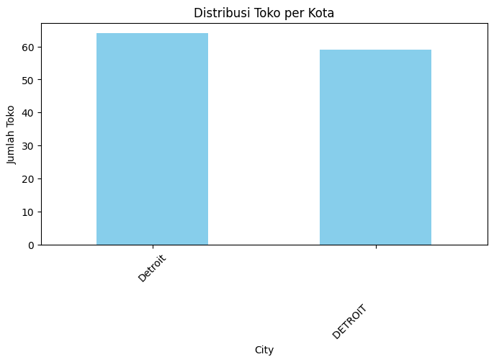
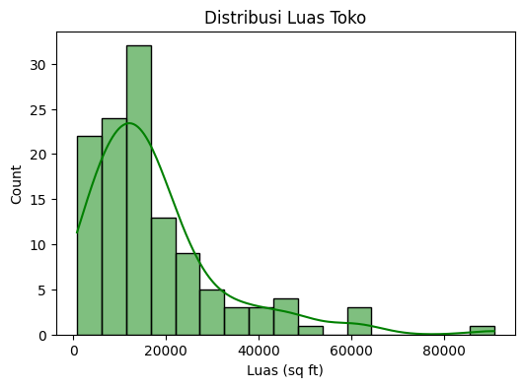
X
Visualization

Slide 8
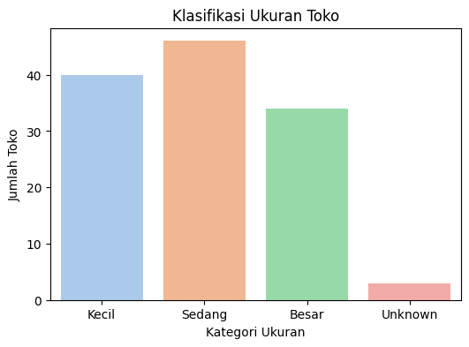
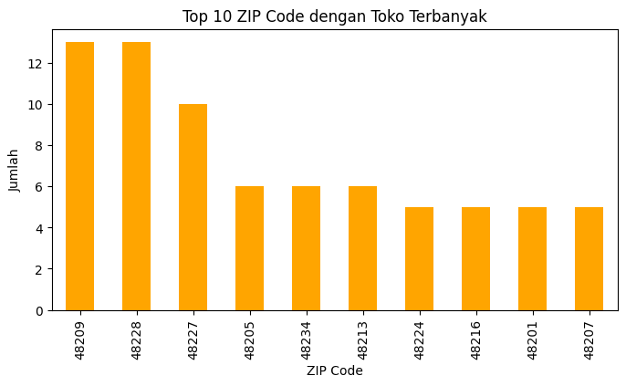
X
Visualization

Slide 9


X
AI Support – IBM Granite
Model used: ibm-granite/granite-3.3-8b-instruct
Powered via Replicate API
Task: Classify Notes → Status (Active/Closed/Unclear) + Reason
Example
Prompt Format :
Step 1: Classify store status
Step 2: Extract reason (keywords)
Sample Output :
Note 3:
- Status: Closed
- Reason: “phone off”, “for sale”

Slide 10

X
Conclusion & Recommendations
• Verify closed stores in the field
• Expand to underserved ZIP areas
• Improve coordinate & contact data
• Use AI for ongoing status monitoring

Slide 11

X
Thank You
0821 2684 3636
rudyrahayu19@gmail.com
https://www.linkedin.com/in/rudirahayu

